Slide 1

Adobe Challenge – 2019 (MLB)
By:
Dinesh Varma Indukuri
Chandra Megha Penchala
Venkata Subramanian Gopalakrishnan

Slide 2

Objective
The goal of our analysis is how MLB create a in-stadium experience, improve online experience to audience, understand site performance.
Areas of Interest
KPI’s ( Visits, Avg. Time spent on Page, AOV)
Recommendations

Slide 3
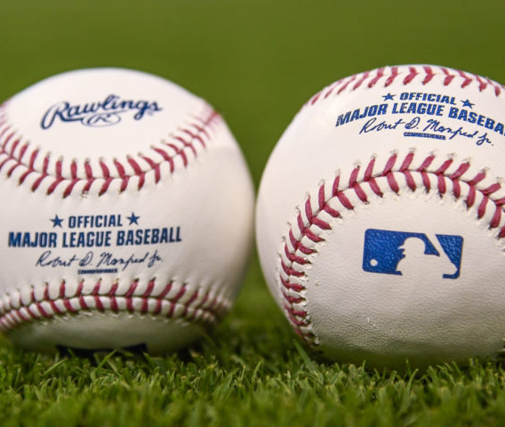
Timeframe for Analysis*
11/1/2018 – 10/31/2019
This includes :
(Off Season) +
(Playoffs) +
(World Series)
*Source: MLB_2019 MLB_2018

Slide 4
MLB Audience
MLB Online Experience
Page Analysis
Video On-demand Views
Ticket Purchases
Areas Of Interest

Slide 5

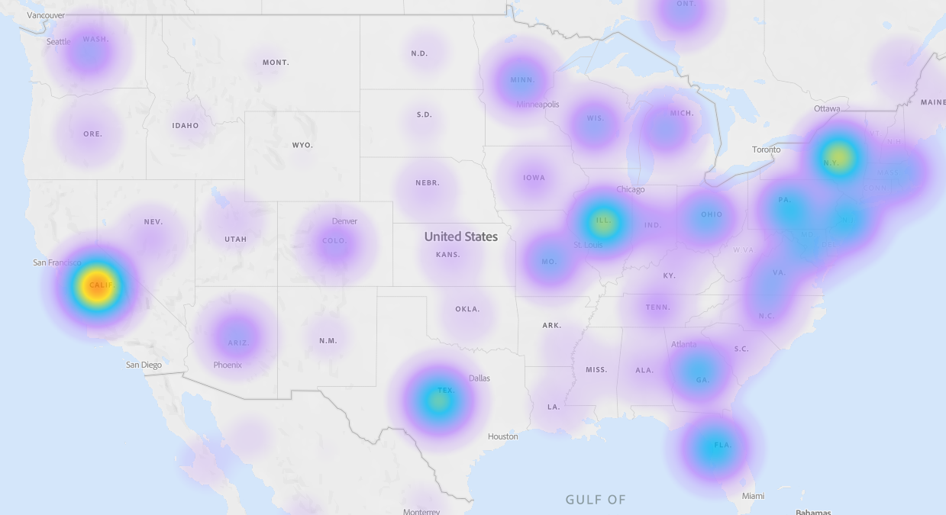
MLB Audience
States generating highest mobile traffic
Mobile, PC, Tablet – accounts for most traffic to MLB.com

Slide 6
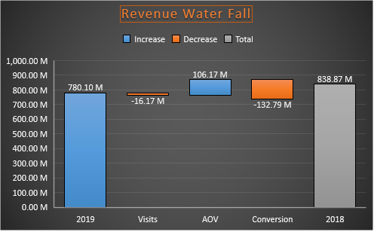
MLB Audience
Visits, Conversion generated a decline in revenue
Tickets.com, Ticketmaster pages are more profitable compared to MLB pages
Recommendation
MLB must consider investing on referrer sites (tickets.com, ticketmaster)
*AOV = Revenue/Orders

Slide 7

MLB Online Experience
Average Page Views/ Visits
4.95
Average Visits/ Visitor
3.70
During Jun’19 – Sep’19
Pages with less load times are having more visits
Page load time has impact on audience’s online experience

Slide 8
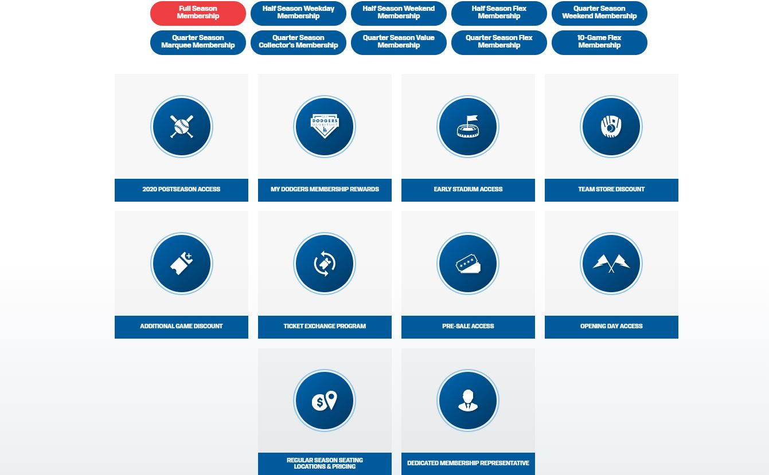
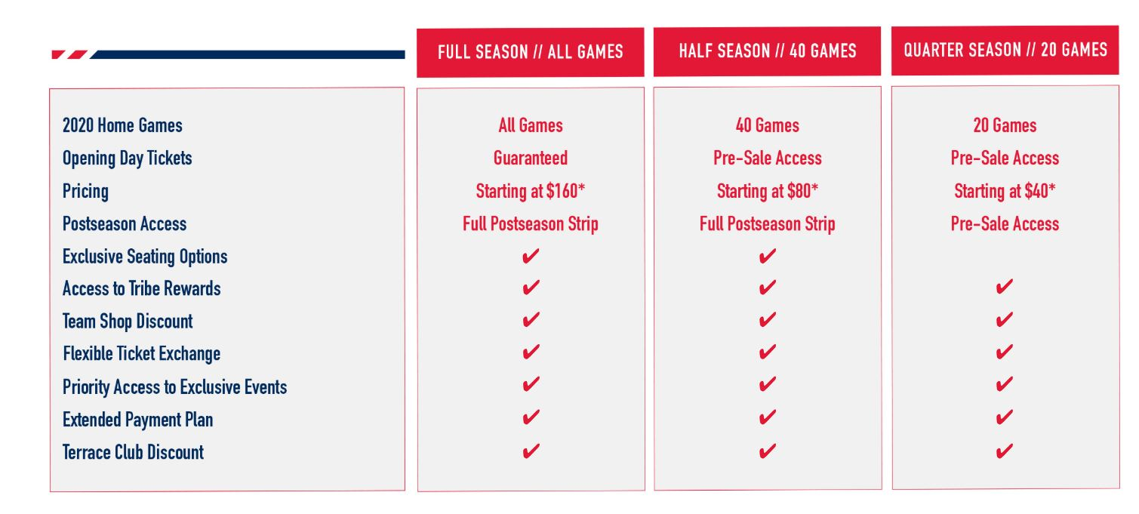
MLB Online Experience
Combo Plans,
Plans Comparison,
Page Load times, …….. Effects visitors online experience and effects conversion rate.

Slide 9

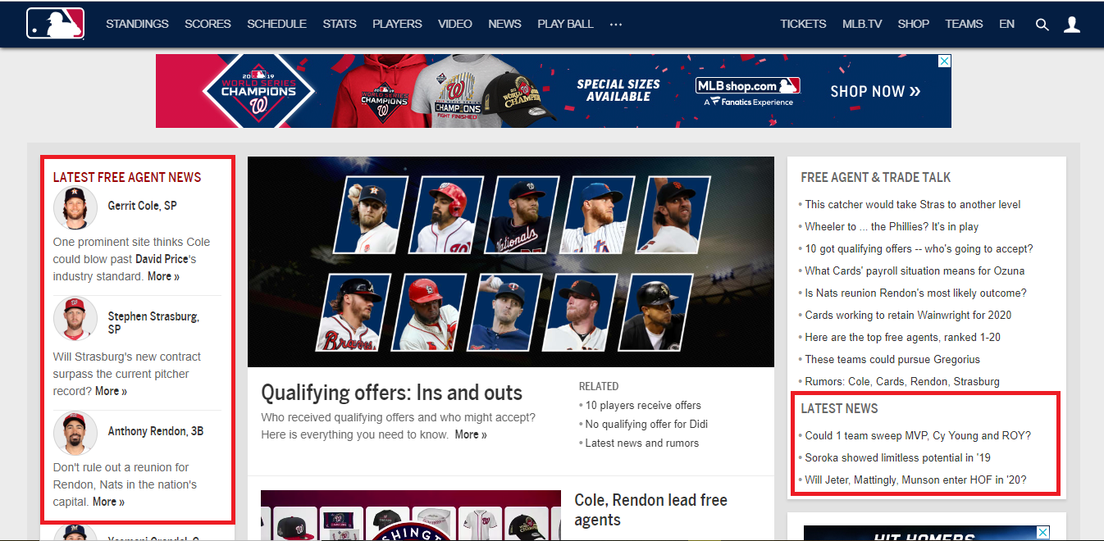
Page Analysis
(News Article)
Recommendation
Based on low time spent on news section : Use carousel view of news which can increase viewers to glimpse.

Slide 10

Page Analysis
(Gameday)
Recommendation
Gameday as one of the very popular sites, make it more visible at the homepage to attract more attention.
Call-to-action
Headline

Slide 11

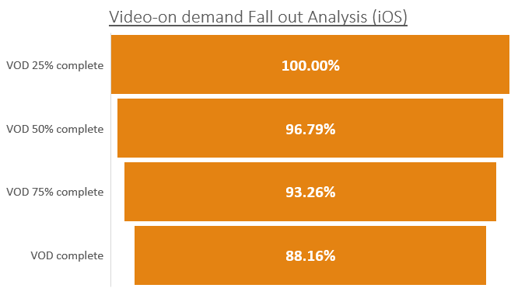
Video On-demand Views
There is only 12% fallout of MLB visitors who do not complete watching the video.
Recommendation
Since we had less fallout of MLB visitors, it is recommended to have relevant system generated videos to keep the audience engaged.

Slide 12

Ticket Purchases
75.04% of ticket sales are from Natural Search + Direct Load

Slide 13
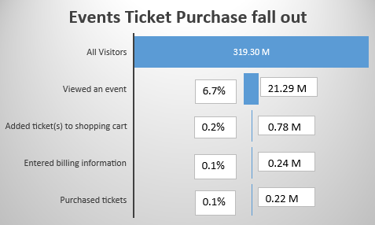
Ticket Purchases
During the season only 0.1% of all visitors purchased the tickets
48% - Purchases placed by returning customers within 7 days
Recommendation
Consider investing on promotions for returning customers.
Note: Product “1001107599999910221801000” generated $18 M revenue in 2018 but only $130 in 2019.
MLB must follow up on performance of products that performed well in one season but not in other.

Slide 14
Recommendations
Concentrate on regions like California, New York, Illinois, Texas during campaigns
MLB must consider investing on referrer sites since they are major source for flagship orders
MLB must work towards reducing page load times and include combo plans/ plan comparison
Introduce a carousel view for news section
Increase visibility for GameDay on Homepage
Recommend to have relevant system generated videos after every streaming video

Slide 15
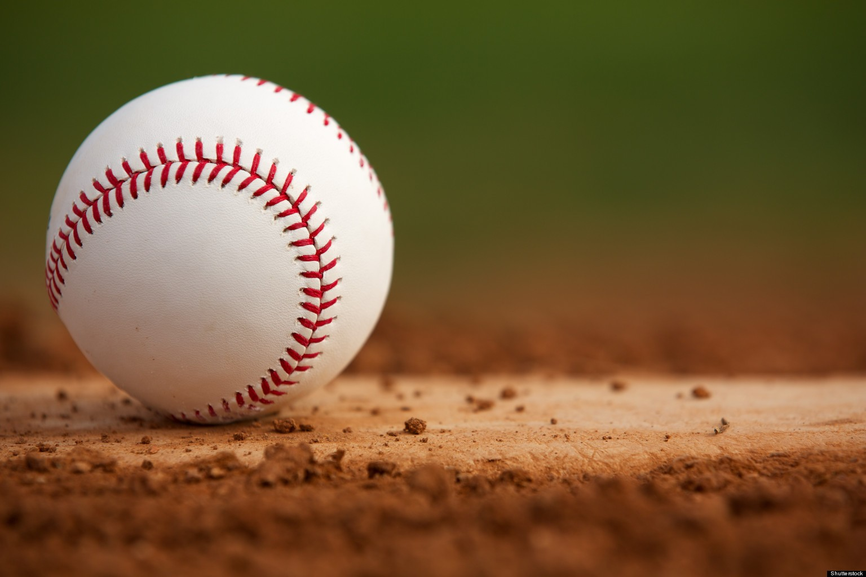
Thank you …

